Slide 1
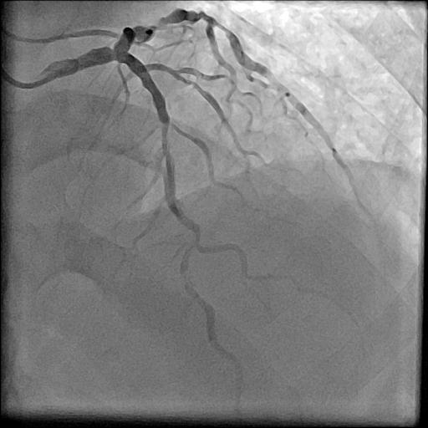
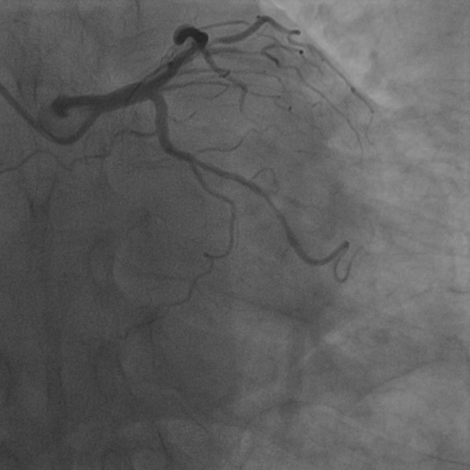
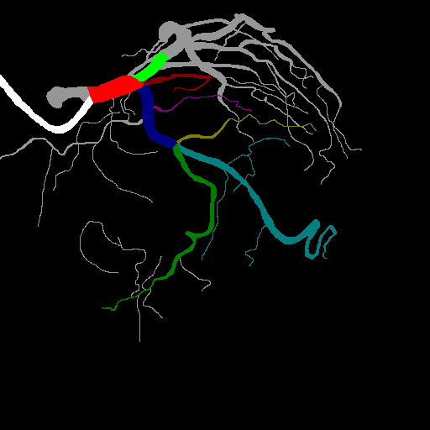
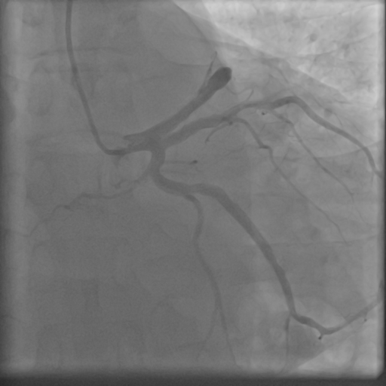
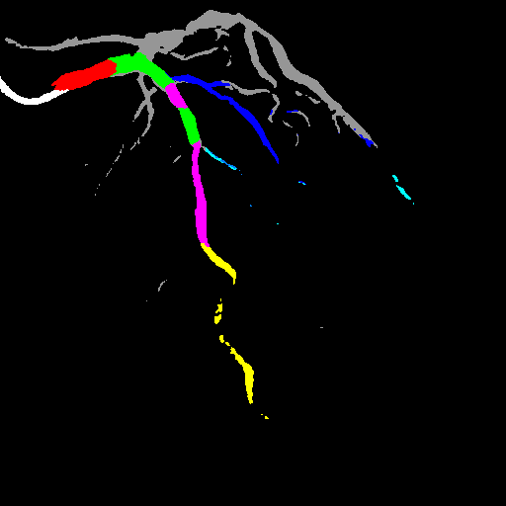
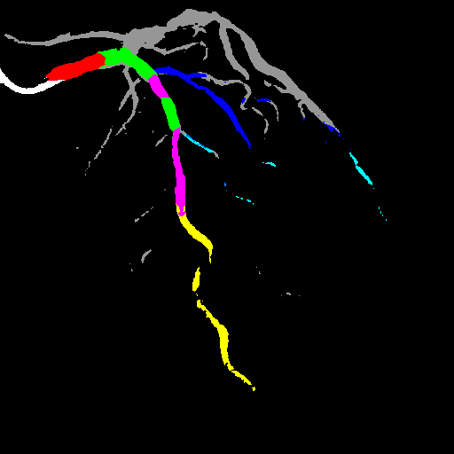
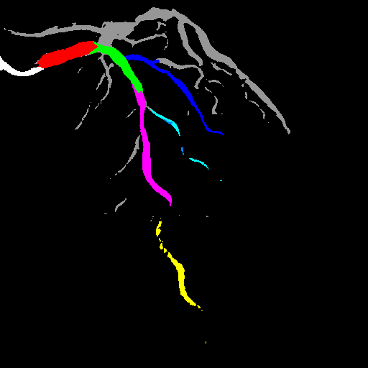
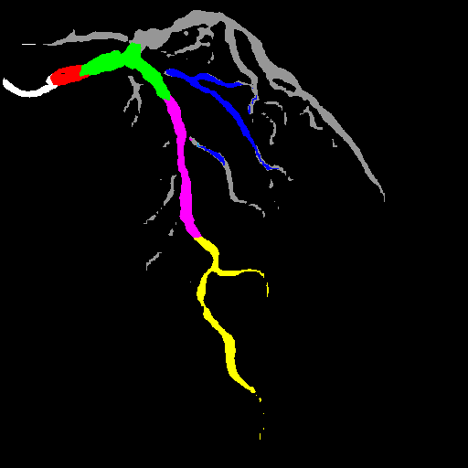
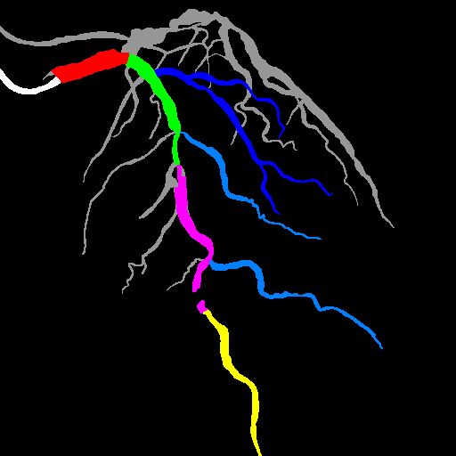
No. 235: Intelligent Recognition of Coronary Angiography by Deep Learning Technology: A Novel Computer-Aided Diagnostic System
Tianming Du¹, Lihua Xie², Xuqing Liu¹, Changdong Guan², Honggang Zhang¹, Bo Xu²
¹Beijing University of Posts and Telecommunications, Beijing, China;
²Fu Wai Hospital, National Center for Cardiovascular Diseases, Chinese Academy of Medical Sciences, Beijing, China
Background: Artificial intelligence (AI) has been applied successfully in various fields related to medical images. However, the use of AI-aided imaging system in percutaneous cardiovascular interventions has never been reported. We sought to utilize intelligent method to recognize coronary angiography by deep learning technology for the very first time.
Methods: We retrospectively collected coronary angiographic images from a large center in China. 70% data were used for developing CAD algorithm, and the other 30% were used for evaluation. A convolutional neural network (CNN) was trained using angiographic images labeled with coronary artery segment, lesion location and lesion characteristics. The precision (percent of the right pixels) and recall rate (percent of retrieved relevant pixels) were used to evaluate the model, and the structure of CNN is illustrated in Figure 3.
Results: 5701 images of 5050 patients are involved in our study, where 3990 images are used for training data to establish the CNN model, 2711 images for evaluation. A 10-hour computing processing is required for training. Only 50 ms is needed for imaging recognition. For detection task of lesion including diameter stenosis, calcification, thrombus, and dissection, the recall rate is 88.2%, 82.6%, 85.5%, 85.8%, respectively. For segment prediction task, the average precision and recall rates of different angiographic position are 86.3% and 78%. .
Figure 3. Structure of the Neural Network
Input
Encoder
Altrous Conv
Low-level Features
1x1 Conv
3x3 Conv
…
Image Pooling
Figure 1. Data for Training
1x1 Conv
Data for segment training
1x1 Conv
Decoder
Figure 2. Workflow of the CAD System
Unsample
Collecting data (5701 images)
Table 1. Coronary Artery Segments
Concat
Angiographic position | Precision | Recall
CRA | 84.3% | 79.5%
CAU | 87.4% | 64.3%
RCA | 92.8% | 80.1%
RAO_CAU | 84.3% | 60.6%
RAO_CRA | 81.9% | 65.1%
LAO_CRA | 85.9% | 77.3%
LAO | 87.8% | 72.3%
LAO_CAU | 85.3% | 56.6%
Data desensitization
Data pre-processing
Data augmentation (translation,
rotation, scaling)
3x3 Conv
Origin image Labeled image for segment
Unsample
Different color in the labeled image represent different coronary artery..
Data for lesion detection training
Label branches pixel by pixel
Coronary artery segment
Label locations and classes
Lesion detection
Output
Thrombus
Segment Algorithm
Detection Algorithm
n=1000
p=74.9%
n=2000
p=78.3%
n=5000
p=86.3%
Training and testing
model
n=3000
p=80.9%
n=4000
p=83.8%
Training model
Training model
Table 2. Specific Morphology Detection
Conclusions: The study showed preliminary feasibility of deep learning technology in angiographic recognition based on CNN model. Notably, with the increase of training images putting into the network, the model is more robust with higher accuracy.
Testing segment model
Testing lesion detection model
Lesion types | Recall
Stenosis | 88.2%
Calcification | 82.6%
Thrombus | 85.5%
Dissection | 85.8%
Origin image Labeled image for detection
The rectangular box marked in the image is the location of the thrombosis lesion.
Form the CAD System
Generate a treatment plan
Diagnosis
generating

